Slide 1

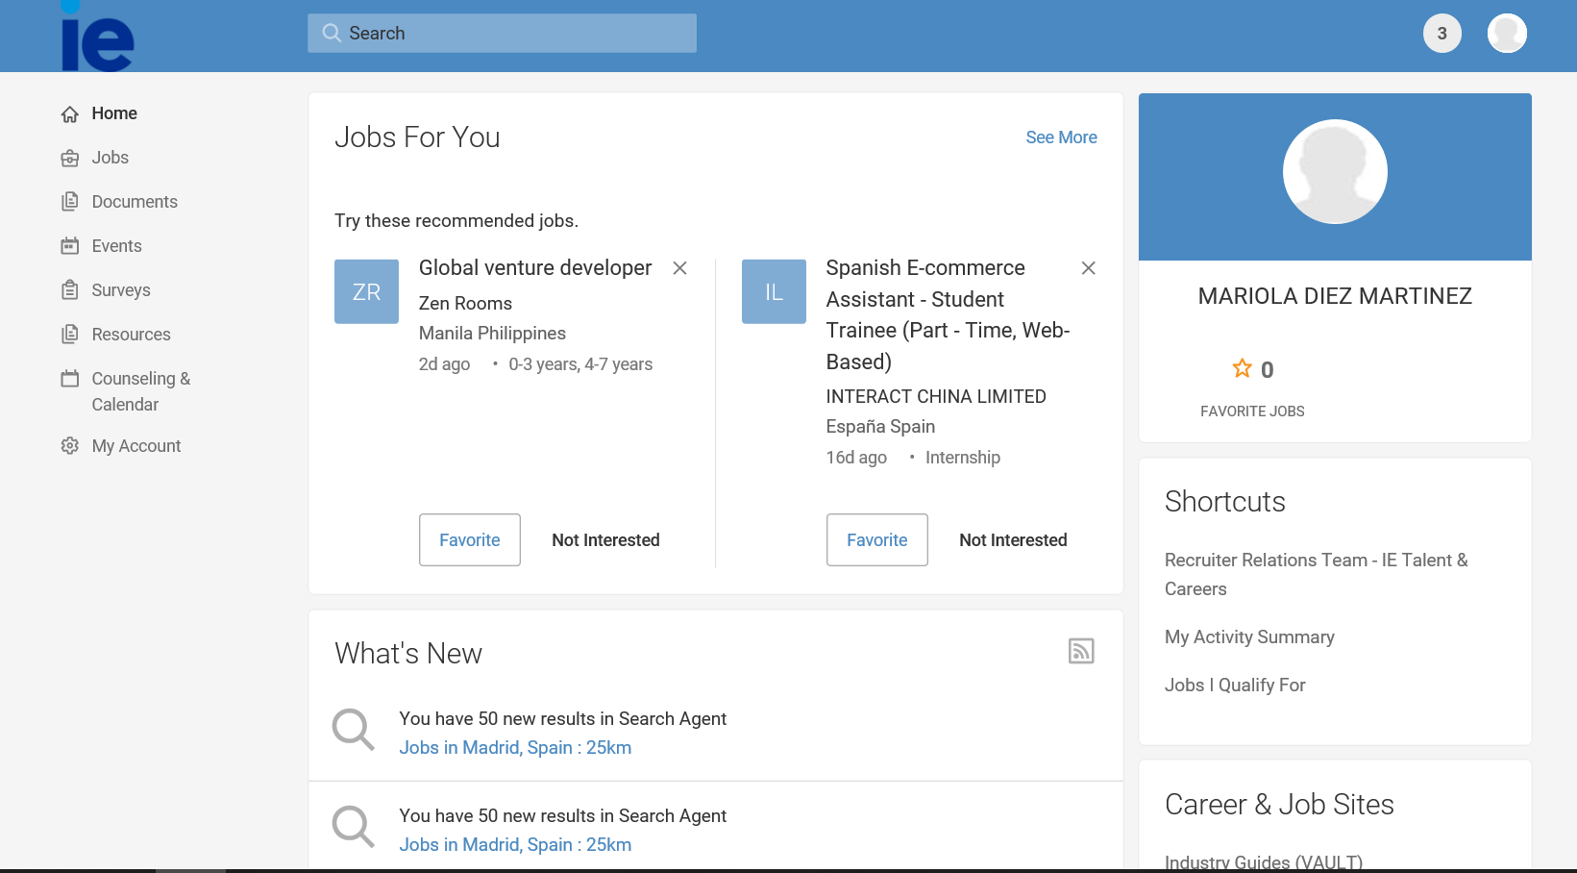
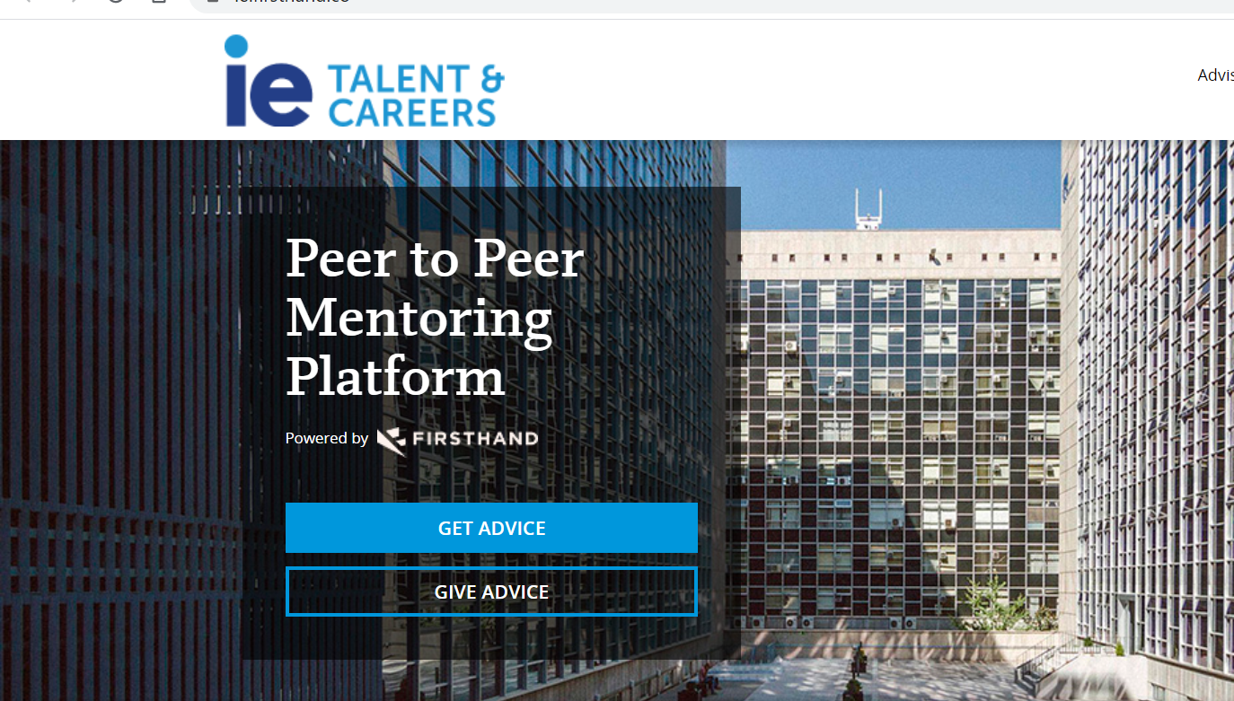

IE Mentoring Platform: Firsthand
Go to https://ie.firsthand.co/
Click on get advice
Set up your profile using IE network log in.
Alumni can also use LinkedIn option to log in.
Make sure to check the exclusive IE Business School advisors who are alumni, willing to give mentoring and even mock interviews!

